Slide 2
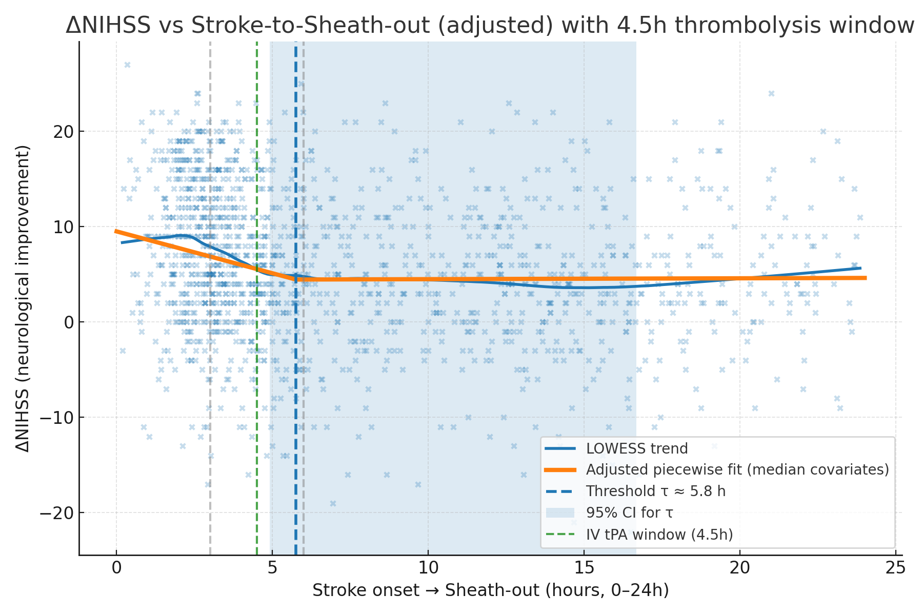

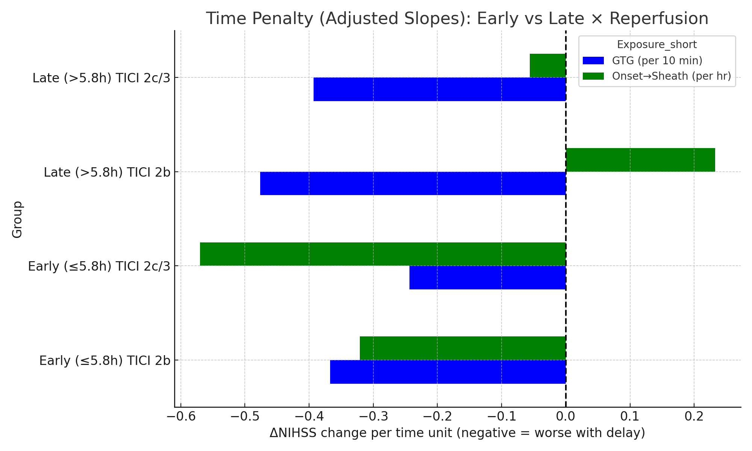
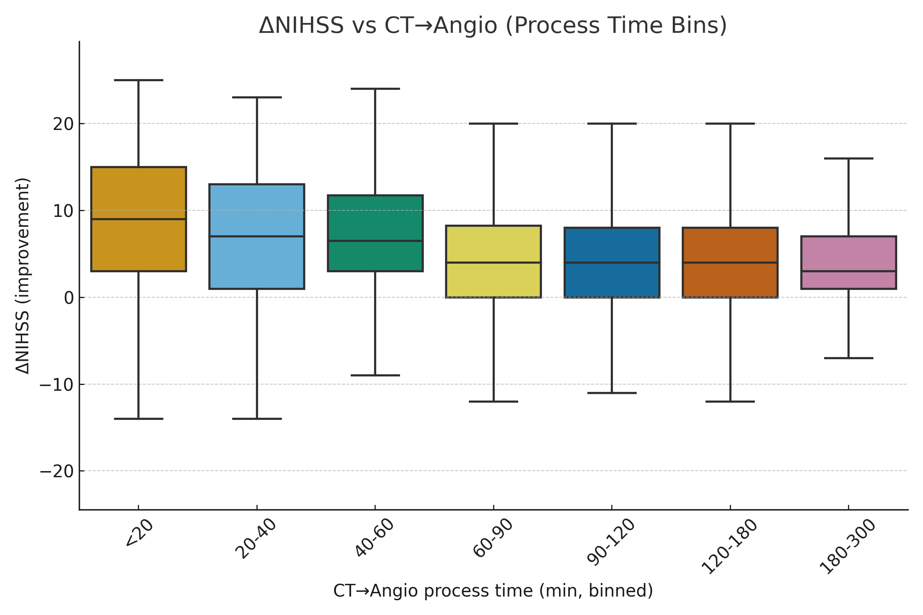

Förbättra stroke kedjan!
Notes:
Early presenters direct vs transfer
Early (<6h):
Direct = +3 NIHSS advantage vs Transfer (adjusted).
Collaterals haven’t had time to “protect” → every extra minute lost really matters.
Functional benefit is strongly tied to speed of reperfusion.
Late (>6h):
Collaterals are the reason the patient is still eligible.
They “hold the brain together” for a while.
So the Direct vs Transfer gap in ΔNIHSS shrinks → the protective effect of collaterals blunts the penalty of added transfer time.
Outcome becomes more dependent on quality of reperfusion (TICI 2c/3 vs 2b) rather than just speed.
👉 In presentation terms:
“In the early window, speed is everything — every minute counts, and direct routing gives a clear +3 NIHSS advantage.”
“In the late window, collaterals buy time. The penalty of transfer is blunted, and what matters most is achieving excellent reperfusion, not just reperfusion.”
Here’s the adjusted analysis for the Late presenters (>6h, 2024 cohort):
🔹 Linear regression (ΔNIHSS outcome, N = 158, adj. R² = 0.09)
Direct vs Transfer: β = −0.7 NIHSS (p = 0.32) → ❌ No significant difference.
Baseline NIHSS: β ≈ +0.4–0.5 per point (p < 0.001).
Age: NS.

